Slide 1

Department of Computer Engineering,
Presentation On:
“Sign Language Detection System”
Submitted By:
Srishti Gupta(19/428)
Isha Bhargava(20/615)
Supervisor:
Dr. Harish Sharma
Asst. Professor
Rajasthan Technical University, Kota

Slide 2
INTRODUCTION
The world hardly live without communication, no matter whether it is in the form of texture, voice or visual expression.
Communication among deaf and dumb people is carried by text or visual expression
Gesture communication is always in the scope of confidential and secure communication
Hands and facial parts are immensely influential to express the thoughts of human in confidential communication

Slide 3
LITERATURE REVIEW
Author | Publications | Year | Problem | Methodology | Remark
Naresh Kumar | ICCCA | 2017 | Hand Sign Language Recognition | SVM & LDA | Classification to recognition sign language Symbols (97.3%)
Tse-un pan, Li-Yun Lo, Chung-Wei Yeh, Jhe-Wei Li, Hou-tim Liu , Min-Chun Hu | IEEE | 2016 | Real-Time Sign Language Recognition | SVM,PCA & LDA | Images of the same gesture were captured in different lighting conditions (94%)

Slide 4
MOTIVATION
Sign language is learned by deaf and dumb, and usually it is not known to normal people, so it become a challenge for communication between a normal and hearing impaired person.
It strike to our mind to bridge the gap between impaired people and normal people to make the communication easier.
Sign language recognition (SLR) system takes an input expression from the hearing impaired person gives output to the normal person in the form of text or voice.

Slide 5
PROBLEM STATEMENT
Understanding the exact context of symbolic expression of deaf and dumb people is the challenging job in real life until unless it is properly specified.

Slide 6
OBJECTIVE
Communication is always having a great impact in every domain and how it is considered the meaning of the thoughts and expression that attract the researchers to bridge this gap for every living being
The objective of this project is to identify the symbolic expression through images so that the communication gap between a normal and hearing impaired person can easily bridged.

Slide 7
DATA DESCRIPTION
We will analyze 780 images in total.
With each alphabet having 30 images data for more accurate detection.
All the images are resized to 640 x 480 pixels, and we perform both the model optimization and prediction on these downscaled images

Slide 8
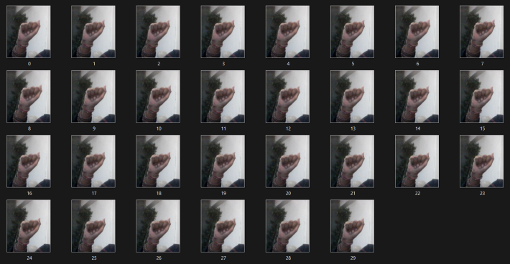
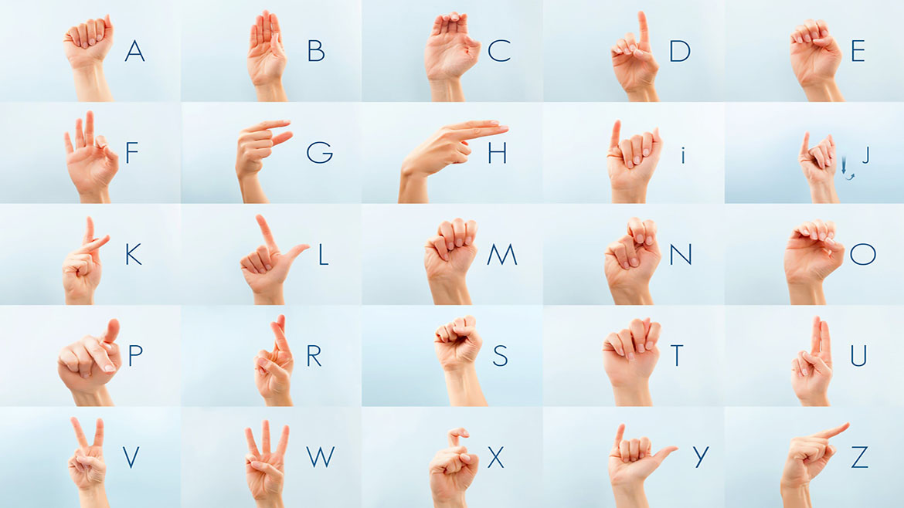
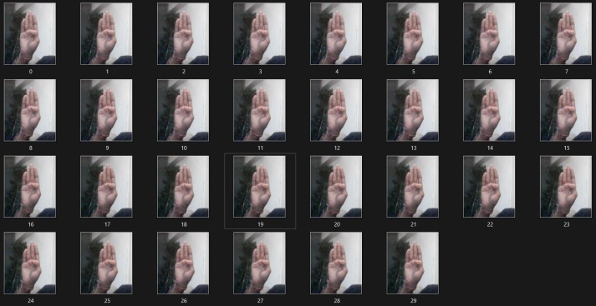
CONT.
Below figure shows an example from every class of sign images dataset.

Slide 9
PROPOSED WORK
In this work, we proposed an idea to use Machine Learning and Deep Learning to make a Sign language Detection Model, for International Sign Language.
Deep Learning-
ANN-An artificial neural network is an interconnected group of nodes, inspired by a simplification of neurons in a brain. Here, each circular node represents an artificial neuron and an arrow represents a connection from the output of one artificial neuron to the input of another.
Machine Learning-
SVM-Support Vector Machine (SVM) is a supervised learning machine learning algorithm that can be used for both classification or regression challenges. However, it is mostly used in classification problems, such as text classification.

Slide 10

IMPLEMENTATION
Data Collection- Using OpenCV
Acquire the image
Acquire frames in real time
cap=cv2.VideoCapture(0)
directory='Image/'
while True:
_,frame=cap.read()

Slide 11
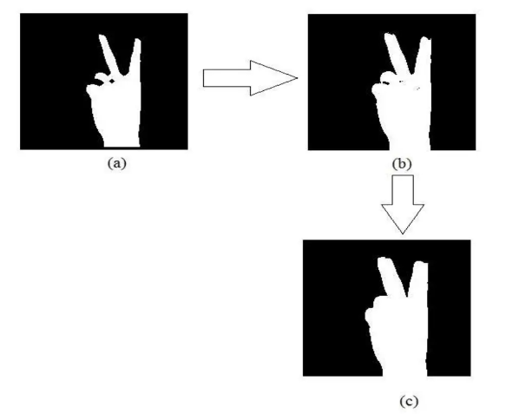
IMPLEMENTATION
Image Preprocessing
-Morphological Transform
-Blurring
-Thresholding

Slide 12
IMPLEMENTATION
DATA ACQUISATION
IMAGE PROCESSING
(SEGMENTATION)
FEATURE EXTRACTION
(KEYPOINT PLACEMENT)
APPLY SVM
CLASSIFICATION

Slide 13
IMPLEMENTATION
Gesture Detection
Import necessary packages
Initialize models.
Read acquired data(images)
Text Implementation
Recognize hand gestures
Detect hand keypoints

Slide 14
DATAFLOW DIAGRAM
USER
GESTURES
CAMERA
VIDEO STREAM
EXTRACT HAND
PREDICTED LABEL
OPENCV
SVM
FRAMES
TRANSFORM TO FRAMES
ANN
PREDICT THE GESTURE

Slide 15
WORKING
Firstly the Data need to be acquired.
For data acquisition we use Open CV to trigger the web cam operations and save the frames as images in .png format.
Then the segmentation of each image is needed to be done.
Edges of the each image and is blurred and for threshold extraction of the hand.

Slide 16
WORKING
Then the function model is trained for the key point generation on the hand data images.
After the key point is drawn on each image, the app model need to be trained for the real time comparison of webcam frames to the acquired data
Each frame is compared with the each data set, and the data set with most accuracy is displayed on the cam window.

Slide 17
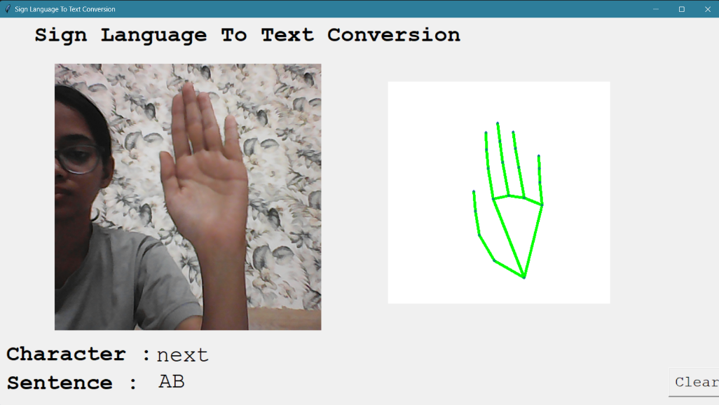
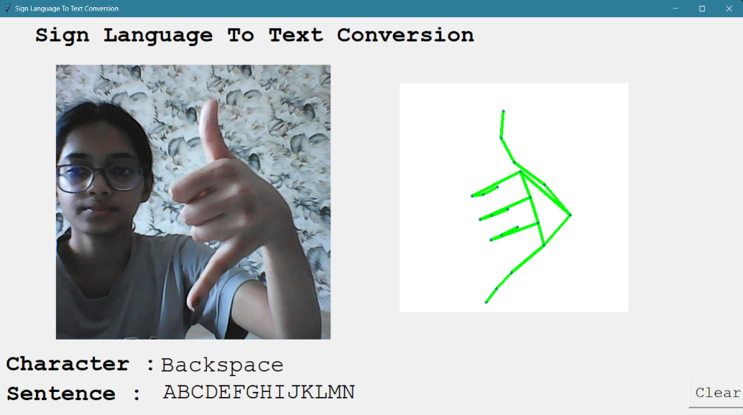
RESULT
Current sign language detection model can detect gestures and make sentences with the accuracy of above 90%

Slide 18
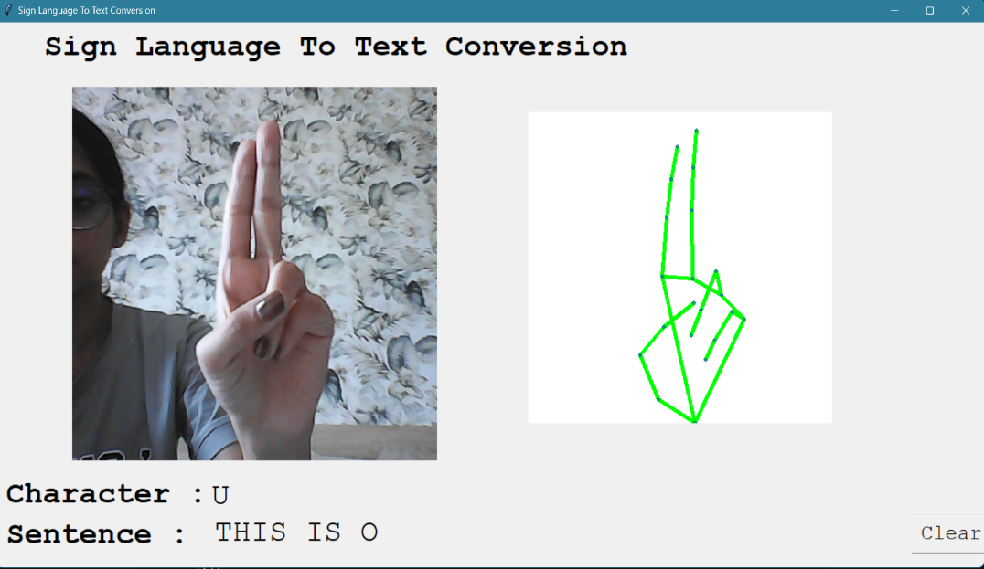
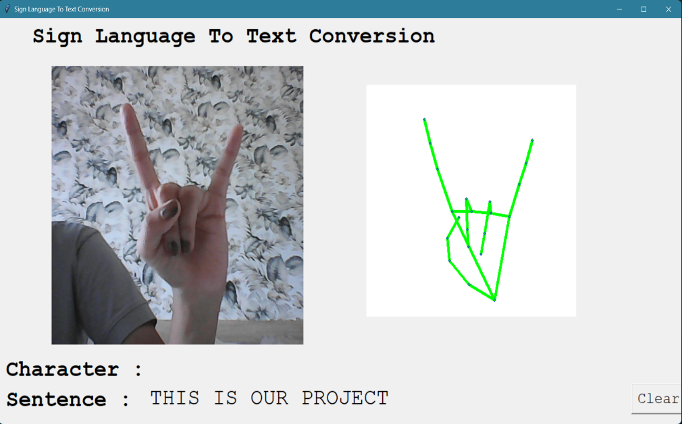
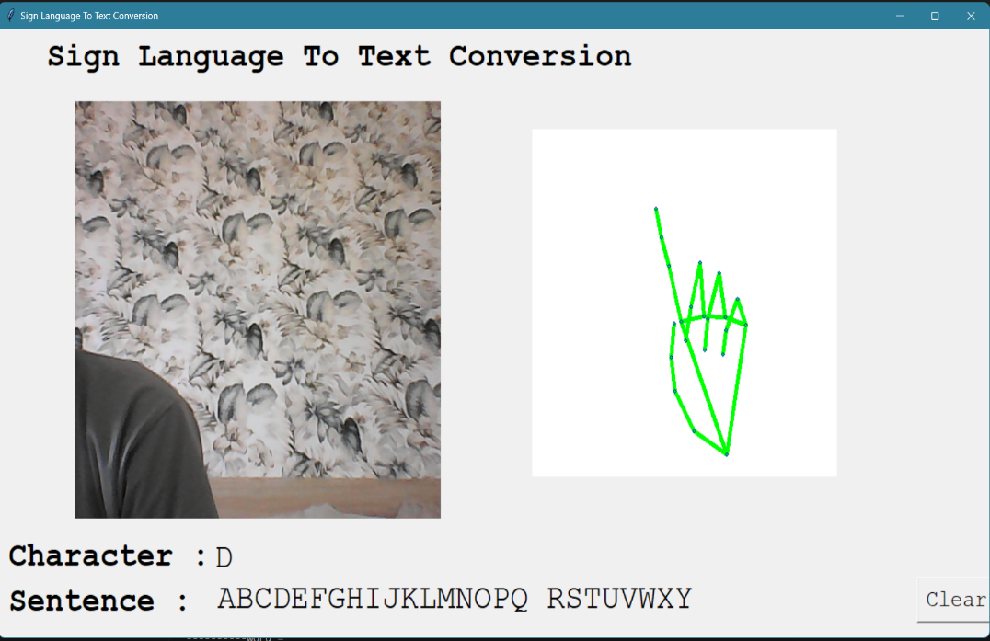
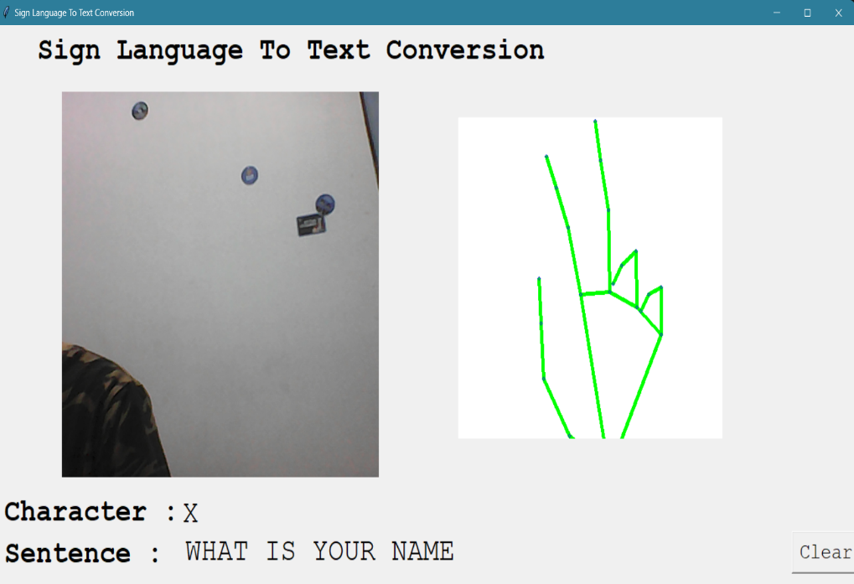

Slide 19
CONCLUSION
In this project, we proposed an idea for feasible communication between hearing impaired and normal person with the help of deep learning and machine learning approach using international sign language.
This proposed work ensures accuracy of above 90% for all the alphabets of International Sign Language

Slide 20
REFERENCES
User-Independent American Sign Language Alphabet Recognition Based on Depth Image and PCANet Features Walaa Aly; Saleh Aly; Sultan Almotairi | IEEE Access Year: 2019.
Sign Language Recognition Using Multiple Kernel Learning: A Case Study of Pakistan Sign Language Farman Shah; Muhammad Saqlain Shah; Waseem Akram; Awais Manzoor; Rasha Orban Mahmoud; Diaa Salama Abdelminaam | IEEE Access Year: 2021
OpenCV Image processing library www.learnopencv.com
Scikit Learn - Documentation http://scikit-learn.org/stable

